Slide 1
Optimization in Modern Power Systems
Transmission Expansion Planning Under Uncertainty
46750 – Optimization in Modern Power Systems
Group 5 | DTU | November 2025

Slide 2
Case Introduction
The Danish Transmission System Operator (Energinet) faces a critical strategic decision: how to optimally plan transmission network expansion under increasing renewable penetration and spatially uneven load growth.
Problem: When to invest in new transmission capacity?
Context: Growing renewable energy hub at node 1, concentrated urban demand at node 2 using fossil fuels, thermal generation at node 3
Challenge: Balance investment costs against future operational benefits under uncertain futures

Slide 3
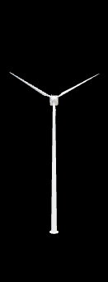
Three-Node Network Structure for Model 1
🏙️
🔥
🔨
Node 1
Node 2
Node 3
Reinforcement
RES Hub
30 DKK/MWh
500 MW capacity
80 MW demand
Urban Load - Fossil
500 DKK/MWh 150 MW capacity
400 MW demand
Thermal Area
200 DKK/MWh
100 MW demand
250 MW capacity
Node 1 – Node 2
50M DKK
0 MW - 200 MW
Line (1-2): 200 MW, Line (1-3): 150 MW, Line (2-3): 100 MW
Candidate: Reinforce (1-2)

Slide 4


Model 1: Myopic Deterministic Expansion
Single-period optimization under perfect foresight for 2050.
H = 8760 hours
$c_{i}$ is marginal generation cost at node i
$p_{i}$ is generation dispatch at node i
$C_{inv}$ is annualized investment cost for line 1-2 reinforcement
x∈{0,1} is binary: build reinforcement (1=yes)
Dispatch + investment decision simultaneously
Minimize annual operating + investment costs – $min H\sum_{i}{c_{i}p_{i}+C_{inv}x}$
DC power flow constraints
Key Finding:
Reinforces line (1-2) because cost of congestion justifies investment
Investment Decision
x = 1 (BUILD)
Annual Cost
26.1M DKK
Node 1 Output
480 MW (96%)

Slide 5
Model 1: Sensitivity Experiments
Experiment 1 - Reduced Urban Demand
d₂ = 200 MW (−50%)
Result: x = 0 (NO investment)
Lower demand eliminates cost of congestion
Experiment 2 - Reduced RES Capacity
G₁ = 300 MW (−40%)
Result: x = 0 (NO investment)
Limited RES removes need for expansion

Slide 6
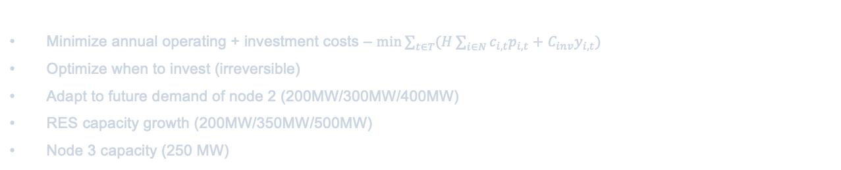

Model 2: Intertemporal / Anticipative Expansion
Multi-period optimization with investment timing (2030, 2040, 2050).
T is periods {1,2,3}
$y_{i,t}$∈{0,1}: invest in period t
$c_{i,t}$ is marginal generation cost at node i
$p_{i,t}$ is generation dispatch at node i
Minimize annual operating + investment costs – $min\sum_{t∈T}{(H\sum_{i∈N}{c_{i,t}p_{i,t}+C_{inv}y_{i,t})}}$
Optimize when to invest (irreversible)
Adapt to future demand of node 2 (200MW/300MW/400MW)
RES capacity growth (200MW/350MW/500MW)
Node 3 capacity (250 MW)
Baseline Solution:
Invest in period 2 (2040) to balance early costs vs. future benefits
Investment Timing
t = 2 (2040)
Total NPV Cost
116M DKK
Avg Annual Cost
~39M DKK/yr

Slide 7
Model 2: Investment Timing Scenarios
Fossil Phase-out
Thermal retirement over time
G₃: 150 → 50 MW
Result: Invest in t = 1
Early investment needed as thermal capacity declines
Late RES Transition
RES build-out delayed to t=3
G₁: 100 MW for t=1,2 and 600 MW for t=3
Result: Invest in t = 3
Postpone investment until RES boom arrives

Slide 8
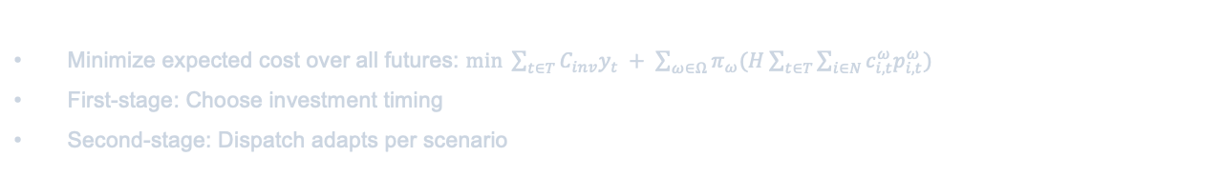
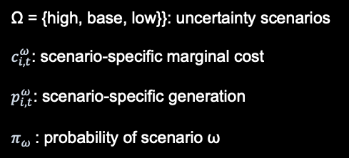
Model 4: Two-Stage Stochastic Planning
Robust investment under uncertainty with scenario-dependent dispatch.
Minimize expected cost over all futures: $min \sum_{t∈T}{C_{inv}y_{t} + \sum_{ω∈Ω}{π_{ω}(H\sum_{t∈T}{\sum_{i∈N}{c_{i,t}^{ω}p_{i,t}^{ω}}})}}$
First-stage: Choose investment timing
Second-stage: Dispatch adapts per scenario
Ω = {high, base, low}}: uncertainty scenarios
$c_{i,t}^{ω}$: scenario-specific marginal cost
$p_{i,t}^{ω}$: scenario-specific generation
$π_{ω}$: probability of scenario ω
Three Scenarios:
High-demand/high-RES | Baseline | Low-demand/low-RES
Robust Timing
t = 1
Hedges Risk
vs Deterministic
Value of three scenarios
± % of cost over time, varying high, base, and low scenarios

Slide 9
Key Findings & Strategic Recommendations
Investment Justification: Line (1-2) expansion is economically robust across deterministic and stochastic scenarios, provided RES buildout and urban demand materialize as planned.
Timing is Critical: Timing of line (1-2) expansion varies depending on scenarios proposed by experiments
Sensitivity: Investment decision highly sensitive to demand growth and RES availability. Delayed RES transition favors postponement, due to prices of generation at node 2 and 3

Slide 10
Thank You!
Questions & Discussion
Optimization in Modern Power Systems | DTU | 2025

